Slide 1

DESIGN AND IMPLEMENTATION OF ENTERPRISE NETWORK
CSE302: COMPUTER NETWORKS
NAME: SARVESH M
REG NO: 224003179
CLASS: III YEAR B-TECH “C” SECTION
COMPUTER SCIENCE ENGINEERING

Slide 2
ABSTRACT
An IT consultancy company called ALPHITE consists of 600 staffs They have recently expanded and as a result, need to move to a new building. A building has been identified but has no network. This means that before they can make to move out, new network service needs to be designed and implemented in the new building. Our focus is to do we have to complete the basic configuration like Enable password and Console password to keep the Network devices secure. Configure the High availability to avoid down time. If any devices go down, the backup device will be available to keep the network on. Configure the DHCP Server to avoid configuring the IP address manually. Use the CAT6 Cable which allows 300Mbps

Slide 3
PROBLEM STATEMENT
We need design a efficient network model, do we have to complete the basic configuration like Enable password and Console password to keep the Network devices secure. Configure the High availability to avoid down time. If any devices go down, the backup device will be available to keep the network on. Configure the DHCP Server to avoid configuring the IP address manually,enable port security,efficient routing and we need to implement the vlan

Slide 4
REFERENCE
1. 1 K. Sohrabi and G. J. Pottie,”Performance of a novel self organization for wireless and enterprise network", Proc. IEEE 50th Vehicular Technology Conf., pp.1222 -1226 1999
2. 2.W. R. Hein Zelman, A. Chandrakasan, and H. Balakrishnan,”Design and optimization of a data centre", Proc. Hawaii Int. Conf. Systems Sciences, pp.3005 -3014 2000
3. A. Woo and D. Culler, "A transmission control scheme for data centre", Proc. ACM/IEEE Int. Conf. Mobile Computing and Networking, pp.221 -2352001
4. V. Bhargava, A. Demers, S. Shankar, and L. Zhang,” AACAW: A Internet access protocol for wireless lanes", Proc. ACM SIGCOMM, pp.212 -225,1994

Slide 5
MODULES
DESIGN:
At each layer i.e. two routers and two multilayer switches are expected to be used to provide redundancy and the network is also expected to connect to at least two ISPs to provide redundancy and each router to the connected to the two ISPs. Satisfy this conditions by design a hieratical model.Using NS2 Simulator I simulate the how the packets has been transmitted and also implemented ospf routing.

Slide 6
MODULES
OSPF ROUTING:
OSPF is a link-state protocol. A link can be considered as a router interface. The link state is a description of that interface and of the relationship with its neighboring routers. For example, a description of the interface includes the IP address and mask of the interface, the type of the connected network, and the connected neighbors. The collection of all these link states forms a link-state database (LSDB).
OSPF is a true LOOP- FREE (route-free loop) routing protocol.
Fast convergence of OSPF: The route changes can be transmitted to the entire autonomous system in the shortest time.
The concept of area division is proposed.

Slide 7
MODULES
VLAN:
A virtual LAN (VLAN) is a logical network created by switches. A VLAN contains Switch Ports that are assigned to the VLAN and has a unique identifier called a VLAN ID.
In most cases, a single physical switch can have multiple VLANs configured on it. This allows for better organization of traffic on the network and improved security as well.
Advantage of using VLANs is that they can help reduce broadcast traffic on the network. Broadcast traffic is data that is sent to all devices on the network, regardless of whether they need it or not. By segregating devices into different VLANS, you can control which broadcasts each device receives, which can help improve performance on the network.

Slide 8
MODULES
SSH:
The Secure Shell Protocol (SSH) is a cryptographic network protocol for operating network services securely over an unsecured network. Its most notable applications are remote login and command-line execution.
SSH applications are based on a client–server architecture, connecting an SSH client instance with an SSH server.

Slide 9
MODULES
PORT SECURITY:
Layer 3 security is very crucial to secure the LAN networks. Switch is directly connected with end hosts. So, there is a possibility that attackers might gain the physical access of end host and infect the host with malicious content and then infect the switch.
To reduce this kind of risk, port security is enable on the switch ports. So that only allowed user can access the port. Port security identifies devices based on the source MAC address of Ethernet frames. Whenever an unauthorized user (other than allowed user) tries to access the port or send the frame, it first checks the MAC address and when it found unauthorized user, the port goes into violation mode (by default violation mode is shut down).

Slide 10
MODULES
SUBNETTING:
Subnetting is the process of creating a subnetwork (also known as a subnet) within a network. Network interfaces and devices within a subnet can communicate with each other directly. Routers facilitate communication between different subnets.
Network address (or) subnet ID: This is always the first address of the subnet.
Broadcast address: This is always the last address of the subnet. A packet forwarded to the broadcast address is broadcasted to all the addresses in a subnet.
Subnet mask (or) netmask: This is the bitmask used to identify the subnet of an IP address by applying bitwise AND operation with the netmask and the IP address. All the IP addresses in a subnet contain an identical most-significant bit group. This is how a router identifies the subnet of an IP address since data packets only contain the destination IP address.

Slide 11
MODULES
DHCP :
The Dynamic Host Configuration Protocol (DHCP) is a network management protocol used on Internet Protocol (IP) networks for automatically assigning IP addresses and other communication parameters to devices connected to the network using a client–server architecture.
The technology eliminates the need for individually configuring network devices manually, and consists of two network components, a centrally installed network DHCP server and client instances of the protocol stack on each computer or device. When connected to the network, and periodically thereafter, a client requests a set of parameters from the server using DHCP.

Slide 12
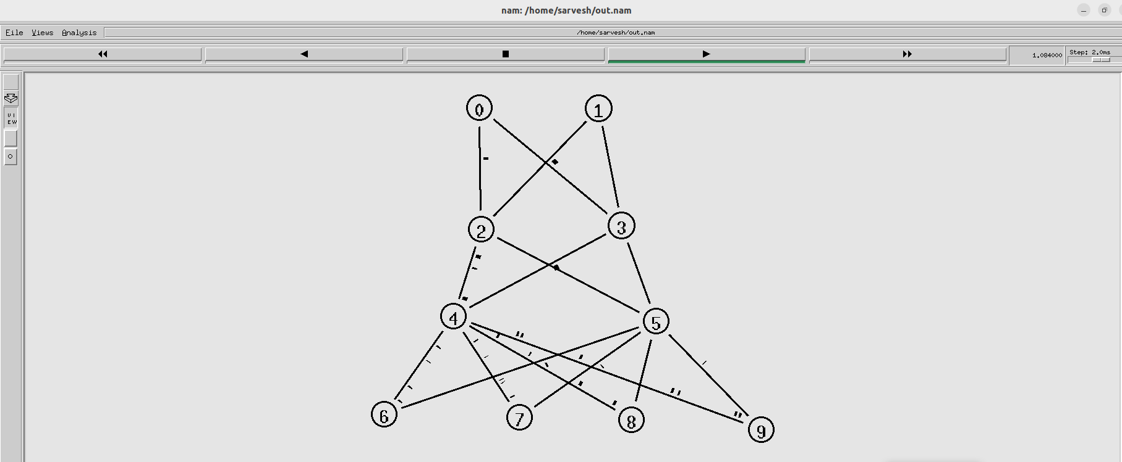
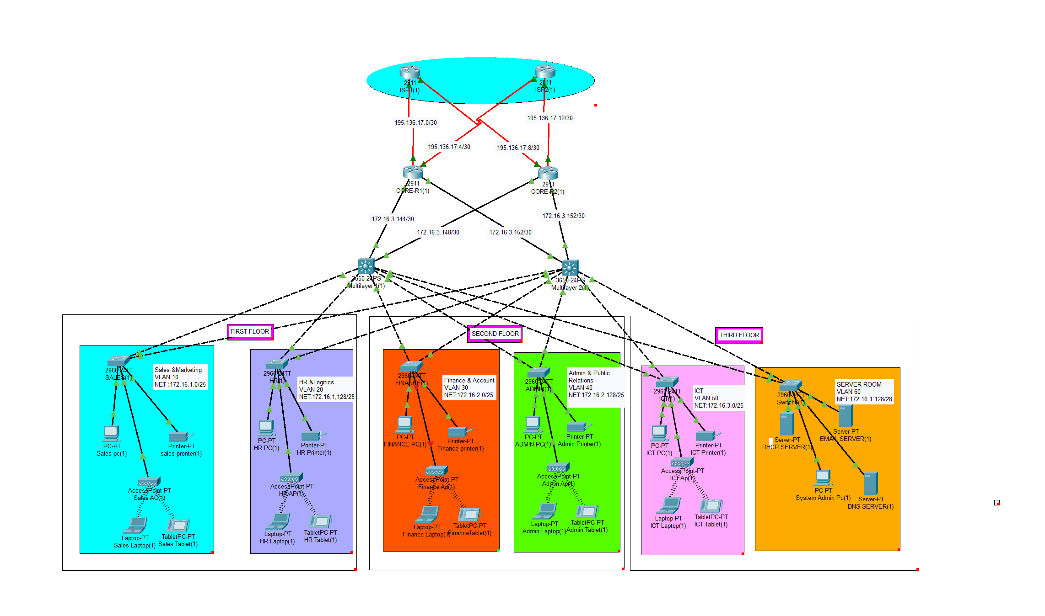
Output Screenshots
Hierarchy Design:

Slide 13
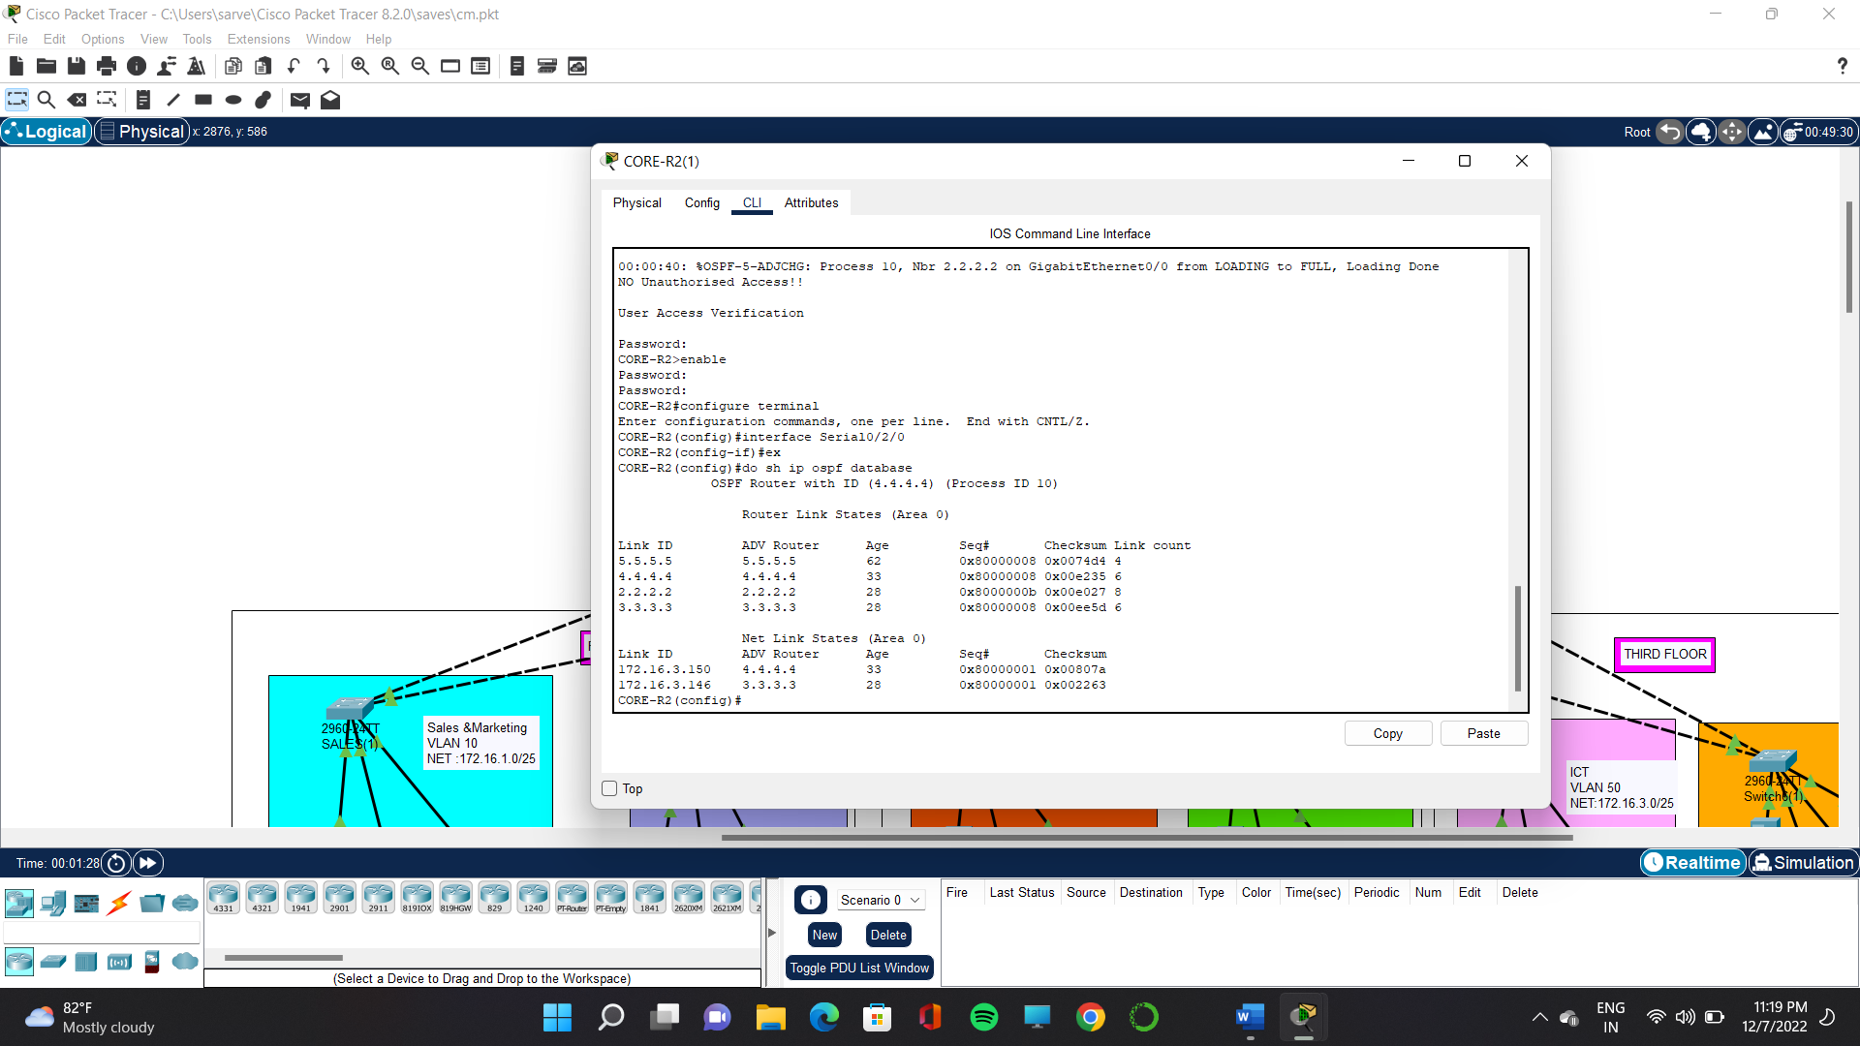
Output Screenshots
OSPF DATABASE:

Slide 14
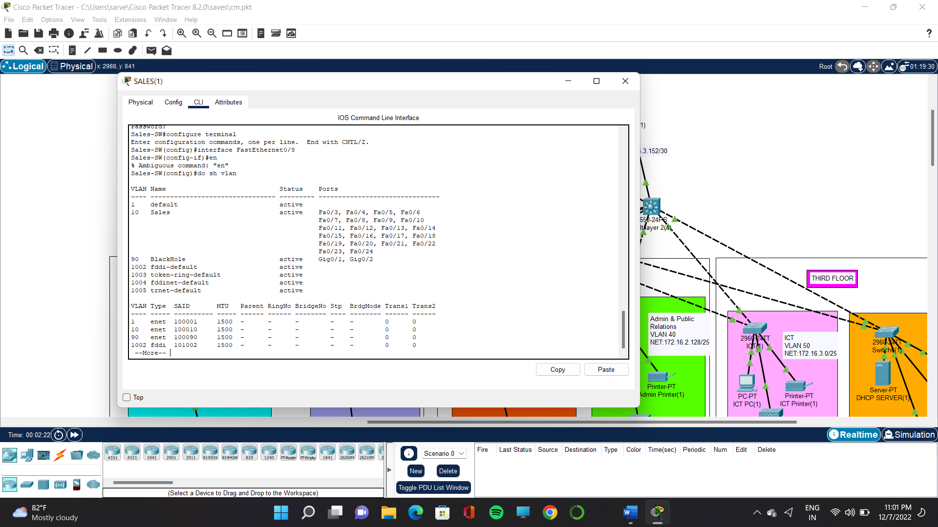
Output Screenshots
VLAN:

Slide 15
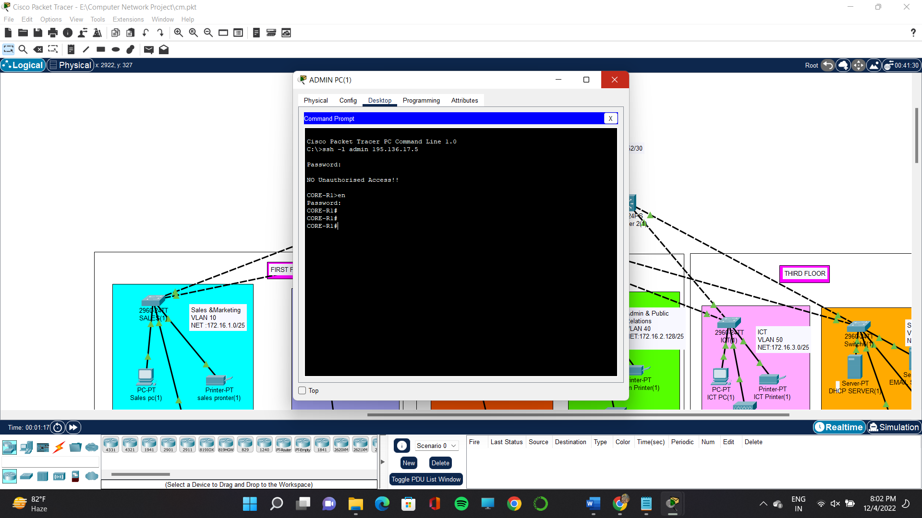
Output Screenshots
SSH:

Slide 16
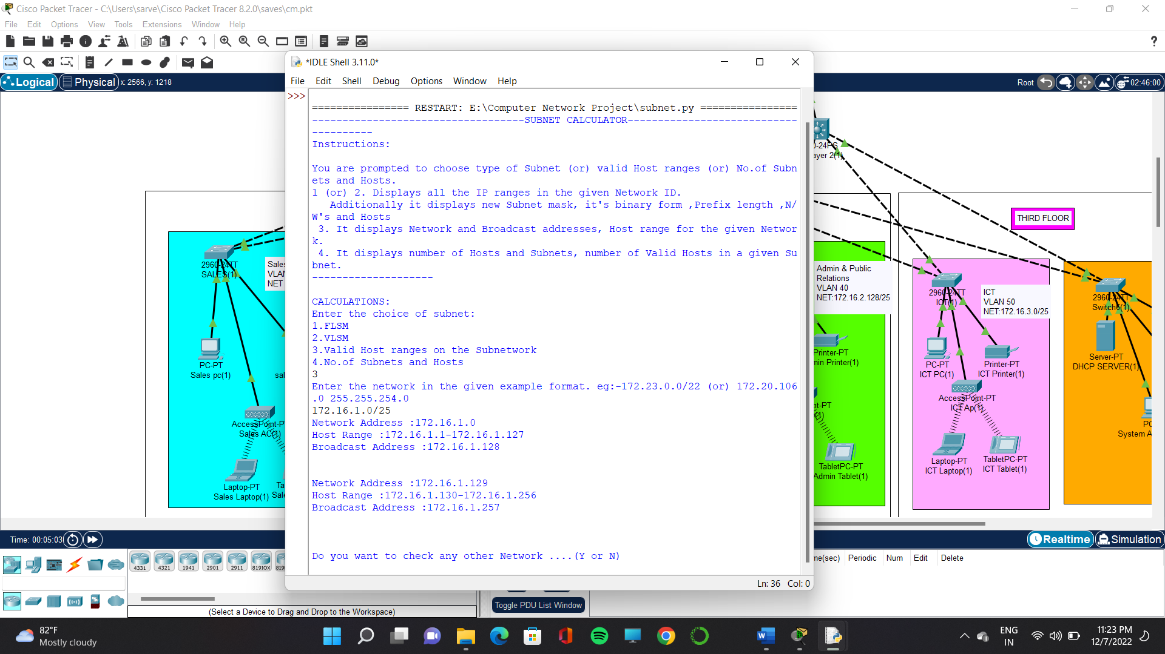
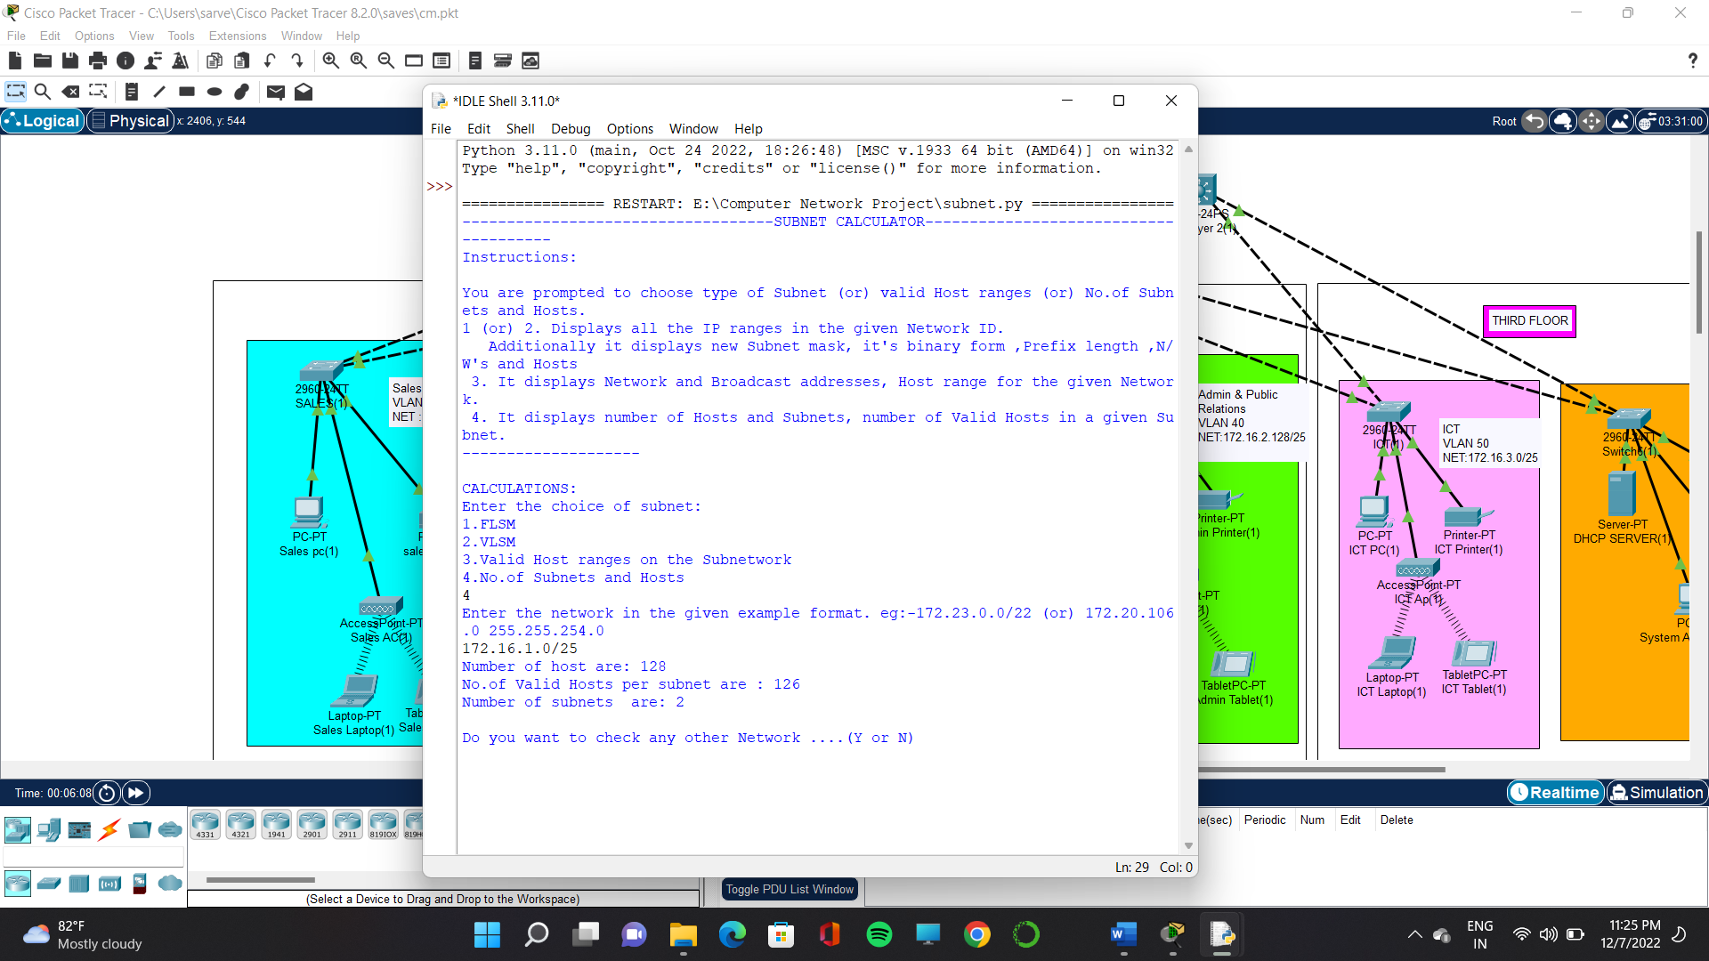
Output Screenshots
SUBNETTING:

Slide 17
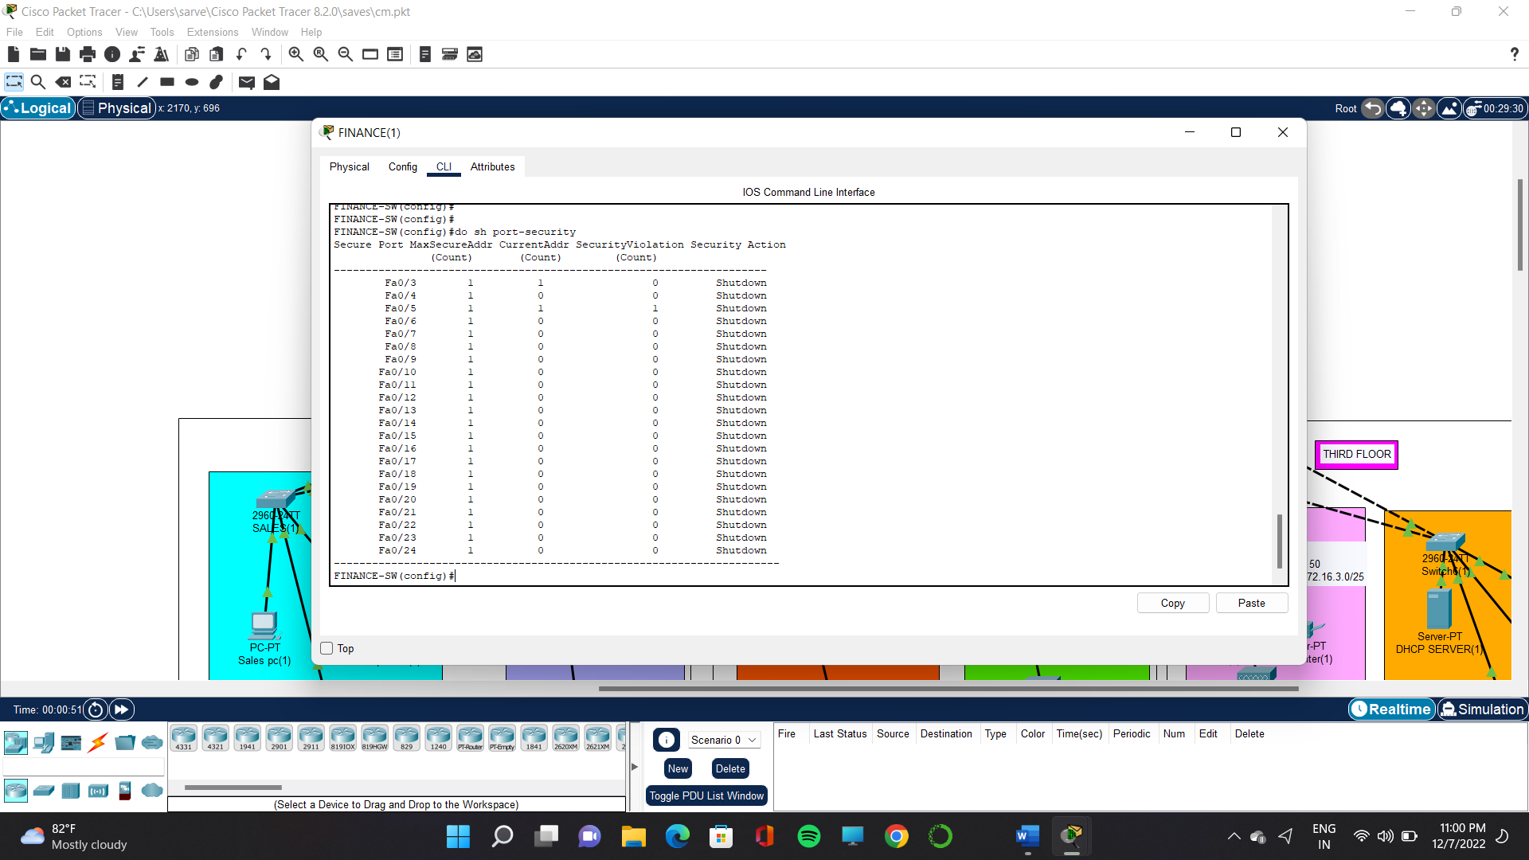
Output Screenshots
PORT SECURITY:

Slide 18
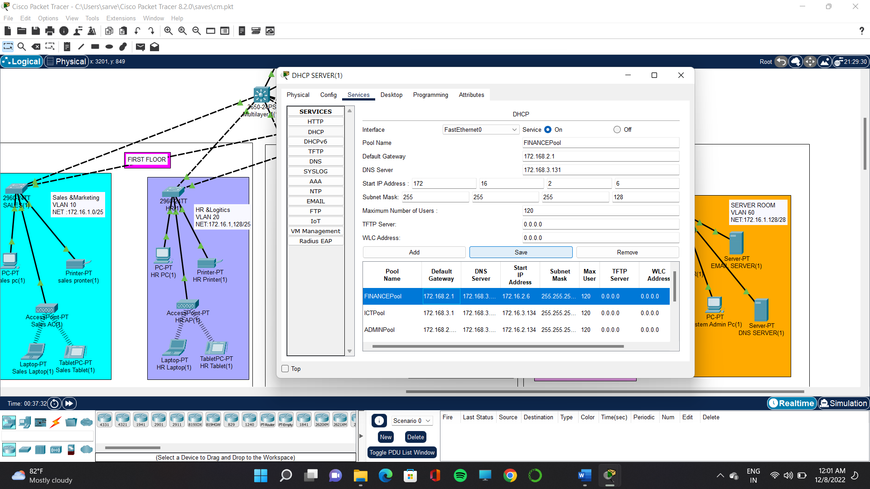
Output Screenshots
DHCP:

Slide 19
CONCLUSION
In this project we learned how the realtime company network is model is designed and implemented using cisco packet tracer we designed and implemented the configuration of dns server,dhcp server,vlan,ssh,port security,wireless network,assign the ip address statically in server room,proper subnetting and using NS2 we show how the packets has been performed in ospf routing
Outcomes implementing our proposed work:
• The network will be more secured and the setup will be understandable by any network admin.
• The network speed will be better
• Redundancy configured for Network devices and ISP
• Separate VLAN configured for all departments like HR, Marketing, Sales and IT
• Port security configured for Finance department for the security purpose.

Slide 20
THANK YOU !!

